Slide 1
Roman Space Telescope
June 12, 2026
Missie Vess Spacecraft Systems Engineer

Slide 2
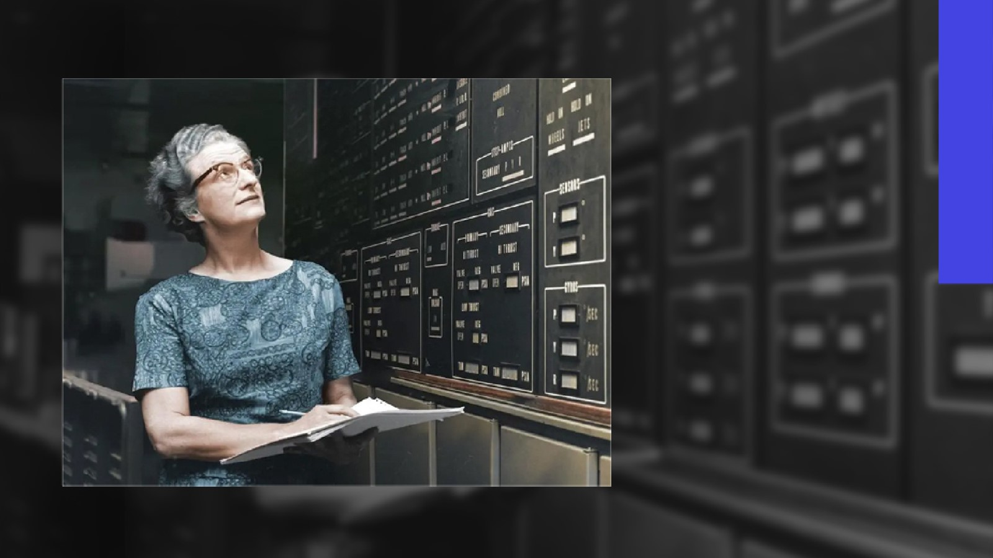
Dr. Nancy Grace Roman
NASA’s First Chief of Astronomy
Visionary behind NASA’s space astronomy program
Champion of women in science
1925–2018

Slide 3
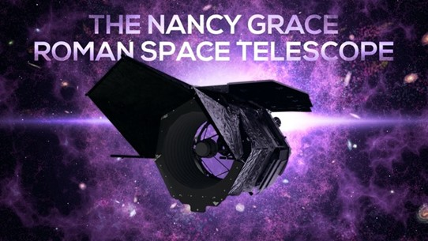
Mission Overview
Science Description
Determine the nature of the dark energy that is driving the current accelerating expansion of the universe Perform statistical census of planetary systems through microlensing survey Survey the NIR sky Provide the community with a wide field telescope for pointed observations
Project Description
A NASA observatory designed to perform wide-field imaging and slitless spectroscopic surveys of the near infrared (NIR) sky for the community
Key Information
Mission Phase: D Launch Date: 8/30/2026 Mission Life: 5 years Category: 1 Class: A tailored Launch Vehicle: Falcon Heavy Technical Authority: Goddard Program Office/Center: ASMP/HQ
Instruments
Wide-Field Instrument (GSFC in-house and BAE Systems (was Ball Aerospace) (WOMA)) Coronagraph Instrument (JPL) - technology demonstration
Partners & Contractors
Partners: ESA, JAXA, CNES, LAM, MPIA NASA Centers: GSFC (lead), JPL, KSC/LSP Significant Subcontractors: AURA/Space Telescope Science Institute BAE Systems (was Ball Aerospace) L3Harris Technologies Teledyne Imaging Systems
We are here

Slide 4
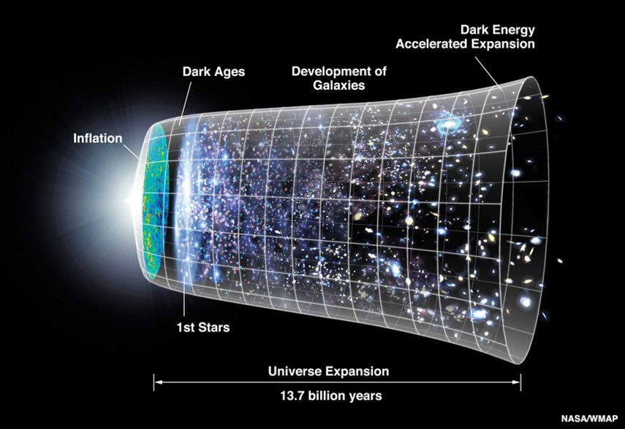
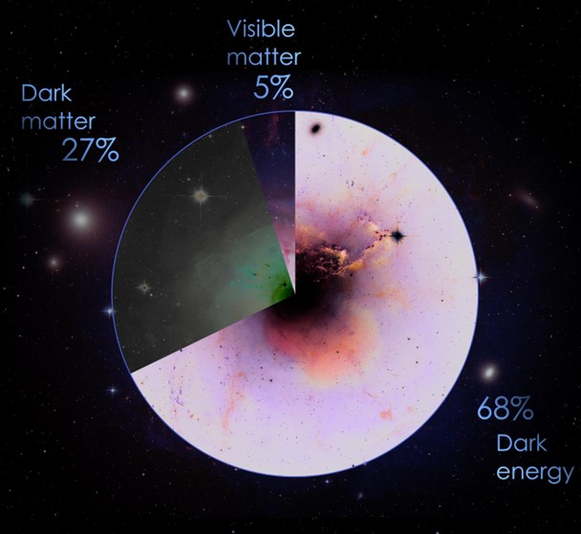
Our Universe
dark energy, which drives the Universe’s accelerated expansion
dark matter, which exerts a gravitational attractive force
The Universe’s expansion history and growth of structure are dominated by two components:
Notes:
https://roman.gsfc.nasa.gov/gallery-technical_data.html (Credit: NASA/STSci/Ann Feild)
Cosmic pie chart: https://svs.gsfc.nasa.gov/12307 (credit GSFC)

Slide 5
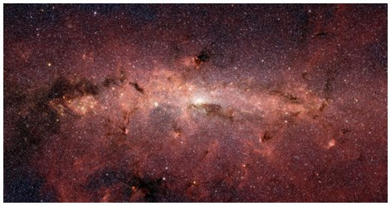
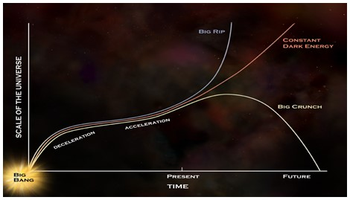
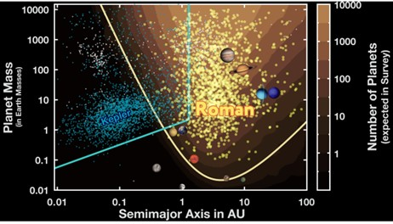
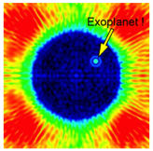
Roman Mission Objectives
Wide Field Infrared surveys
  Imaging and spectroscopy to >26.5 AB mag
Expansion history of the Universe
  Using supernova, weak lensing and galaxy redshift survey techniques
Growth of Structure in the Universe
  Weak lensing, redshift space distortions and galaxy cluster techniques
Exoplanet Census
  Statistical census of exoplanets from outer habitable zone to free floating planets
General Astrophysics Surveys
  Devote substantial fraction of mission lifetime to peer reviewed program
Coronagraph technology demonstration
  Demonstrate exoplanet coronagraphy with
  active wavefront control
Wide-Field Infrared Surveys of the Universe
Dark Energy and the
Fate of the Universe
Exoplanet demographics

Slide 6
Observations Enable Roman Mission Objectives
We meet Roman’s goals through the Core Community Surveys, the General Astrophysics Surveys, and the Coronagraph technology demonstration
Three Core Community Surveys address the 2010 Decadal Survey science goals while providing broad scientific power
  High Latitude Wide Area Survey
    Wide area multiband survey with slitless spectroscopy
    Enables weak lensing, and galaxy redshift cosmology mission objectives
  High Latitude Time Domain Survey
    Tiered, multiband time domain observations of 10s of deg² at high latitudes
    Enables Type Ia supernova cosmology mission objectives
  Galactic Bulge Time Domain Survey
    ~<15 min cadence observations over few deg² towards galactic bulge
    Enables exoplanet microlensing mission objectives
Minimum 25% time allocated to General Astrophysics Surveys
  Mostly via peer reviewed proposals and some additional community defined surveys
  Galactic Plane General Astrophysics Survey currently being defined via community process
90 days for Coronagraph technology demonstration observations, within first 18 months of mission
Astrophysics with wide-field near-IR surveys

Slide 7
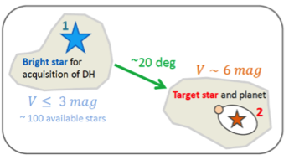
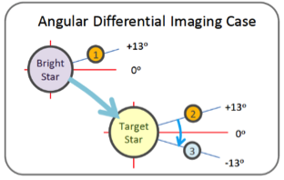
Roman Observing Programs
The Roman Design Reference Mission consists of a five-part observing program:
  High Latitude Wide Area Survey: Spectroscopic & Imaging sky survey for Baryon Acoustic Oscillation (BAO) / Redshift space distortion (RSD) & Weak Lensing/Galaxy Clustering
    Mapping >1,700 deg², observations of ~140 sec (imaging) or ~300 sec (spectroscopy)
  High Latitude Time Domain Survey: Multiple visits to fields at high ecliptic latitudes to discover and track Supernova
    30 hours of imaging and spectroscopic observations every 5 days
  Galactic Bulge Time Domain Survey: Repeated visits to fields near the Galactic bulge to monitor planetary microlensing events
    Repeated viewing of 6 fields every 15 minutes for 60 days
  Exoplanet Coronagraphy: Targeted observations of nearby stars for technology demonstration of high-contrast imaging and spectroscopy
  General Astrophysics Surveys: Allocated time for proposers to observe targets anywhere within the field of regard
    All portions of the sky in the FOR are visible during otherwise-unallocated time
High Latitude Wide Area & Time Domain Surveys
Long FOV (0.82 deg)
Short FOV
(0.42 deg)
1
16
17
32
2
15
18
31
3
14
19
30
4
13
20
29
5
12
21
28
6
11
22
27
7
10
23
26
8
9
24
25
Gap-Filling Dithered Exposures
1
Galactic Bulge Time Domain Survey
Short FOV
(0.42 deg)
2
Return (1.68 deg)
3
4
6
5
To Galactic Center (1.19 deg)
Exoplanet Coronagraphy
Retargeting Slew

Slide 8
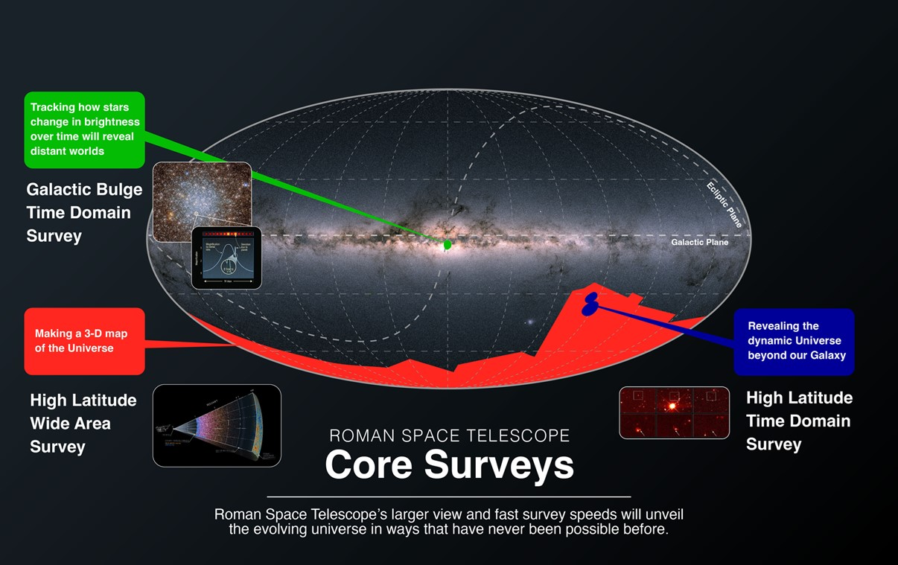

Roman Core Community Surveys
Address Science Requirements While Maximizing General Astrophysics
Process to fully define core surveys in progress now
  Community Surveys are for the community, by the community
Survey Definition
Notes:
High-Latitude Wide Area Survey
Multiwavelength Imaging - Weak lensing measurements of hundreds of millions of galaxies
Spectroscopy (grism) - Redshifts of tens-of-millions of galaxies
High-Latitude Time-Domain Survey
Supernova Cosmology - Light curves for many thousands of supernovae, a subset with prism spectra
Galactic Bulge Time Domain Survey
Exoplanet microlensing – Use light curves for >100 million stars to find ~1400 bound planets and ~200 free floating planets

Slide 9
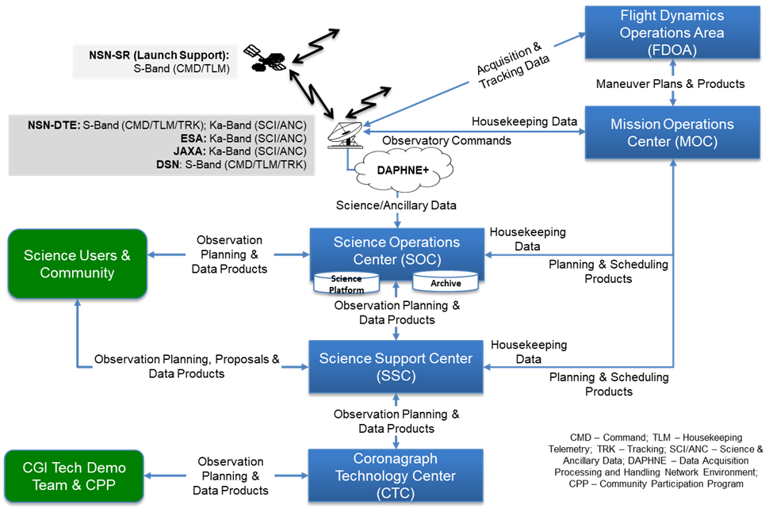
Mission Architecture

Slide 10
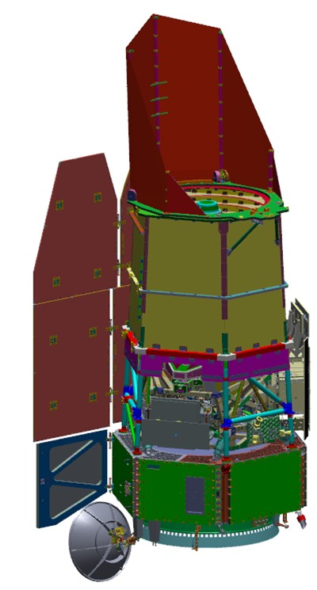
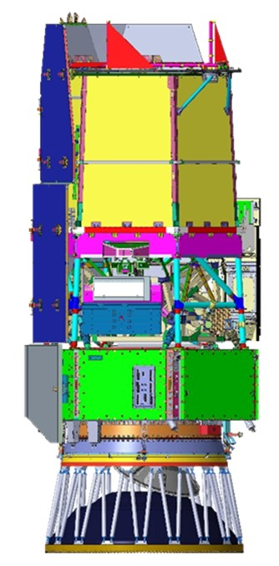
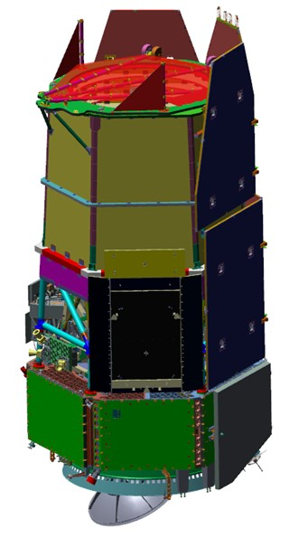
Flight Segment
Observatory
  Reused 2.4m primary mirror and associated components
  Instruments
    Wide Field Instrument
      18 H4RG detectors, 8 filters, 1 prism, 1 grism, 1 dark
    Coronagraph Instrument (Class D, Tech Demo)
      Imaging and spectroscopic modes
  Spacecraft
    3-axis stabilized; 9,950 kg (maximum allowable)
      Measured dry mass is 8056 kg
      Planned wet mass is 9174 kg
    Solar array provides 4100 W at EOL at the extremes of the field of regard
Launch Vehicle – Falcon Heavy
  RXR configuration (side boosters return to launch site)
  3100 sep system with strut PAF

Slide 11
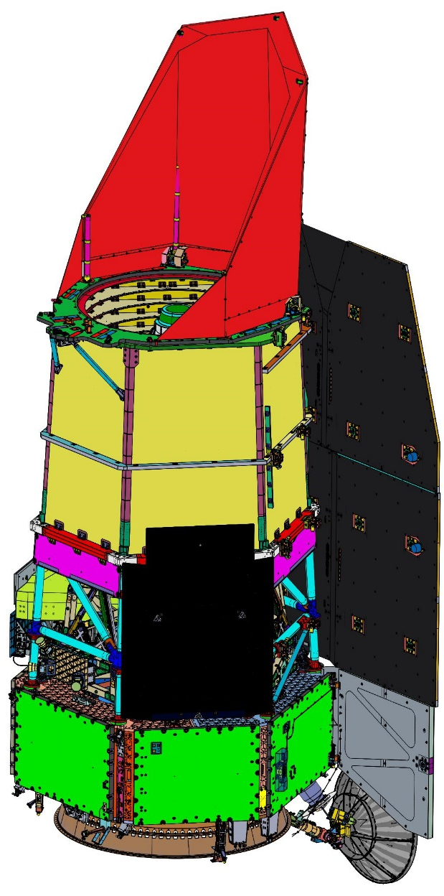
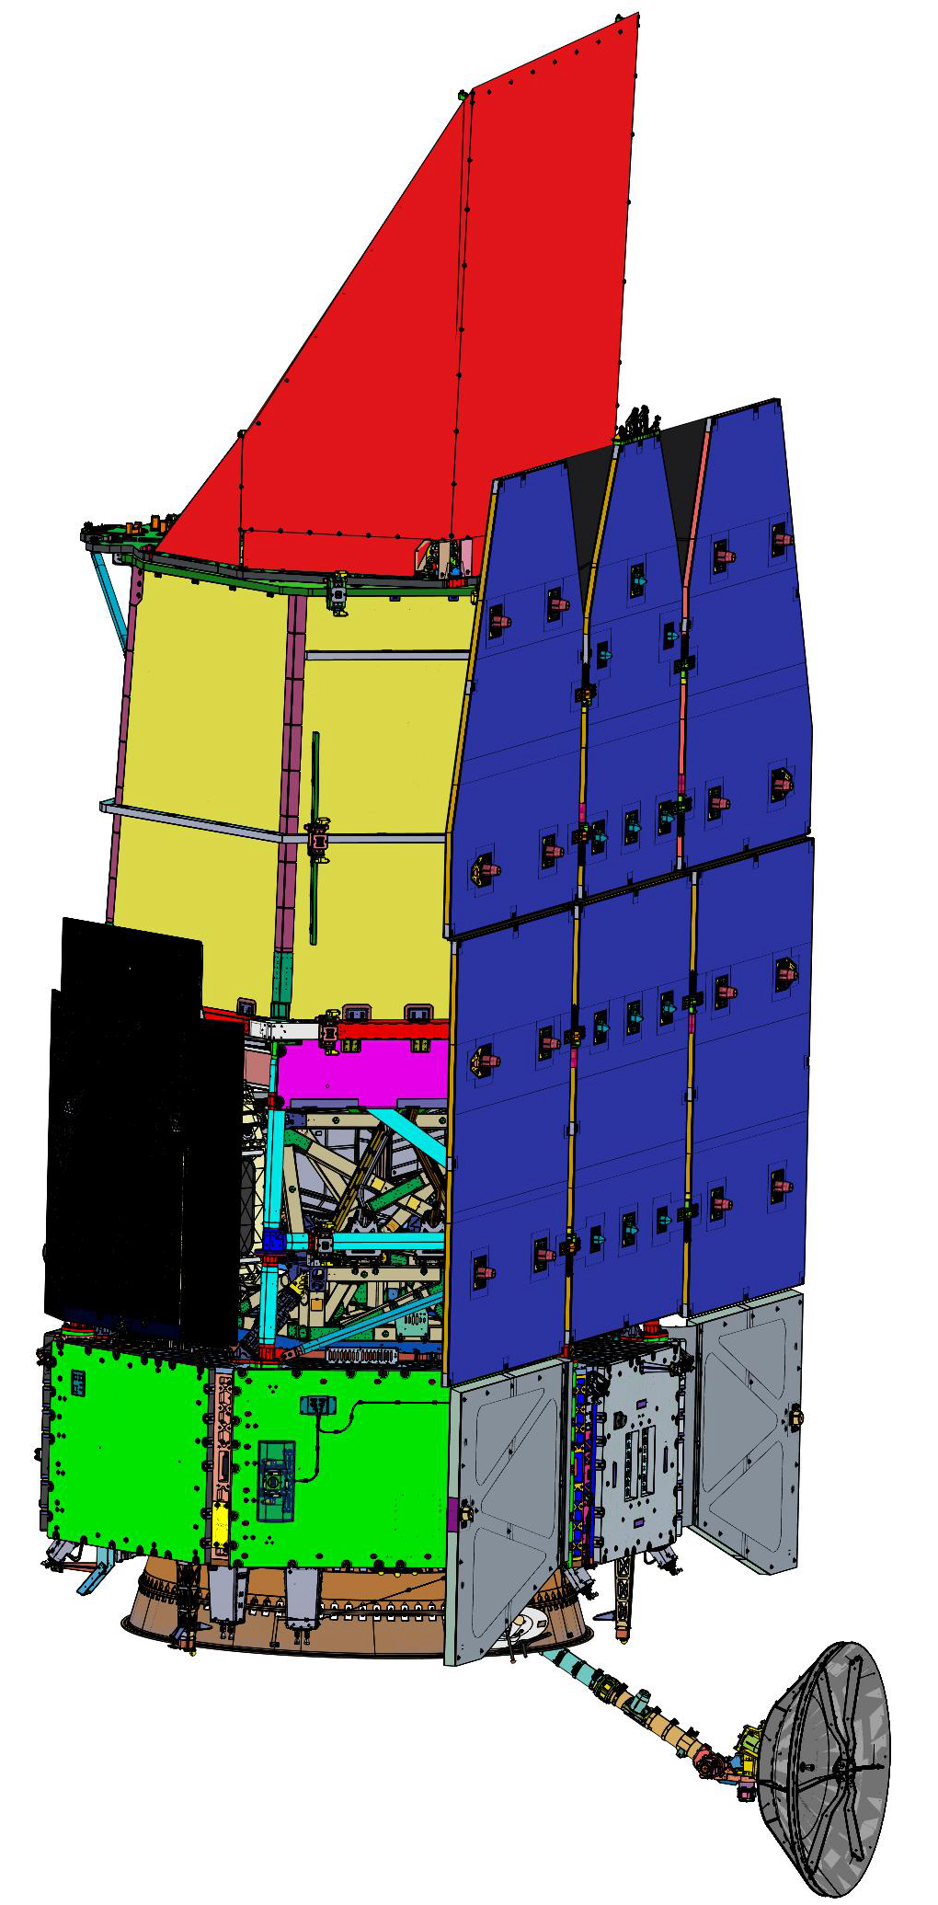
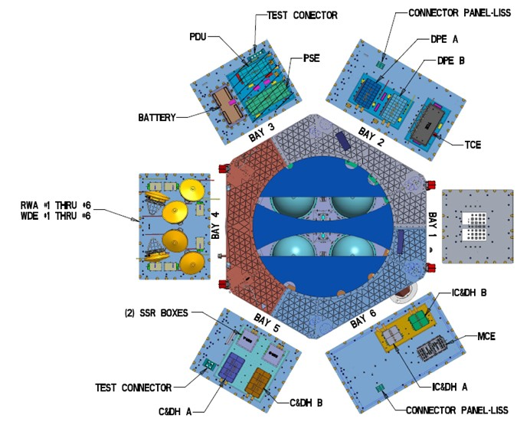
Observatory Overview
  Deployable Aperture Cover (DAC)
Solar Array Sun Shield (SASS)
X_{OBS}
Y_{OBS}
Z_{OBS}
  Outer Barrel Assembly (OBA)
12.7 m
  Coronagraph Instrument (CGI)
  Instrument Carrier (IC)
  Wide Field Instrument (WFI CSM)
  Star Tracker (ST) / Inertial Reference Unit (IRU)
  Lower Instrument Sun Shades (LISS)
Bay 4
Bay 5
Bay 6
  High Gain Antenna System (HGAS) – 2-axis gimbaled
  SC Bus &
  Avionics Panels (x6)

Slide 12
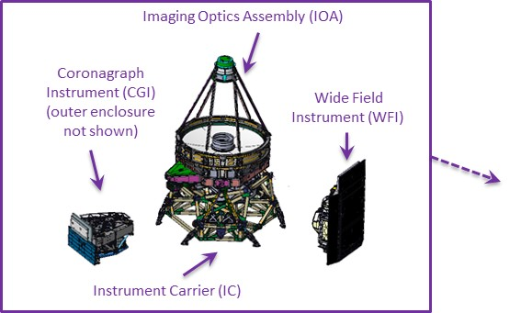
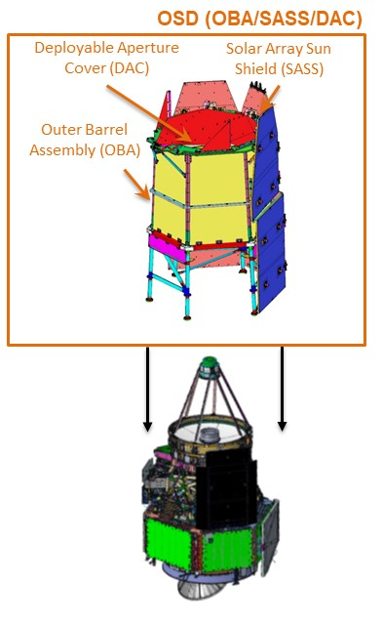
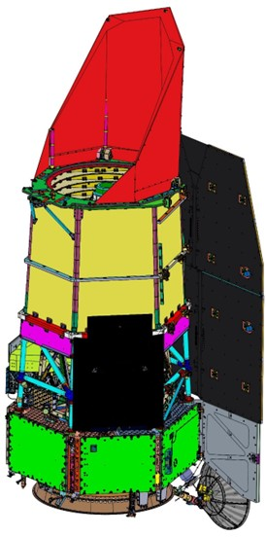
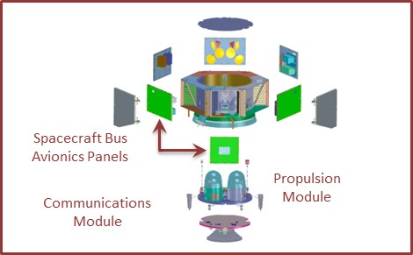
Observatory Expanded View
SCIPA = Spacecraft Bus + Integrated Payload Assembly
Observatory = SCIPA + OBA/SASS/DAC
Integrated Payload
Assembly (IPA)
Spacecraft Bus
Observatory
SCIPA

Slide 13
hardware

Slide 14
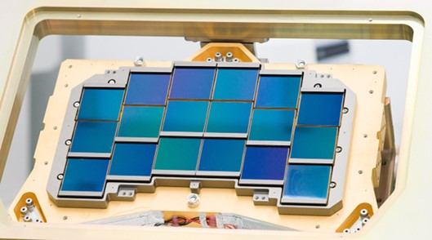
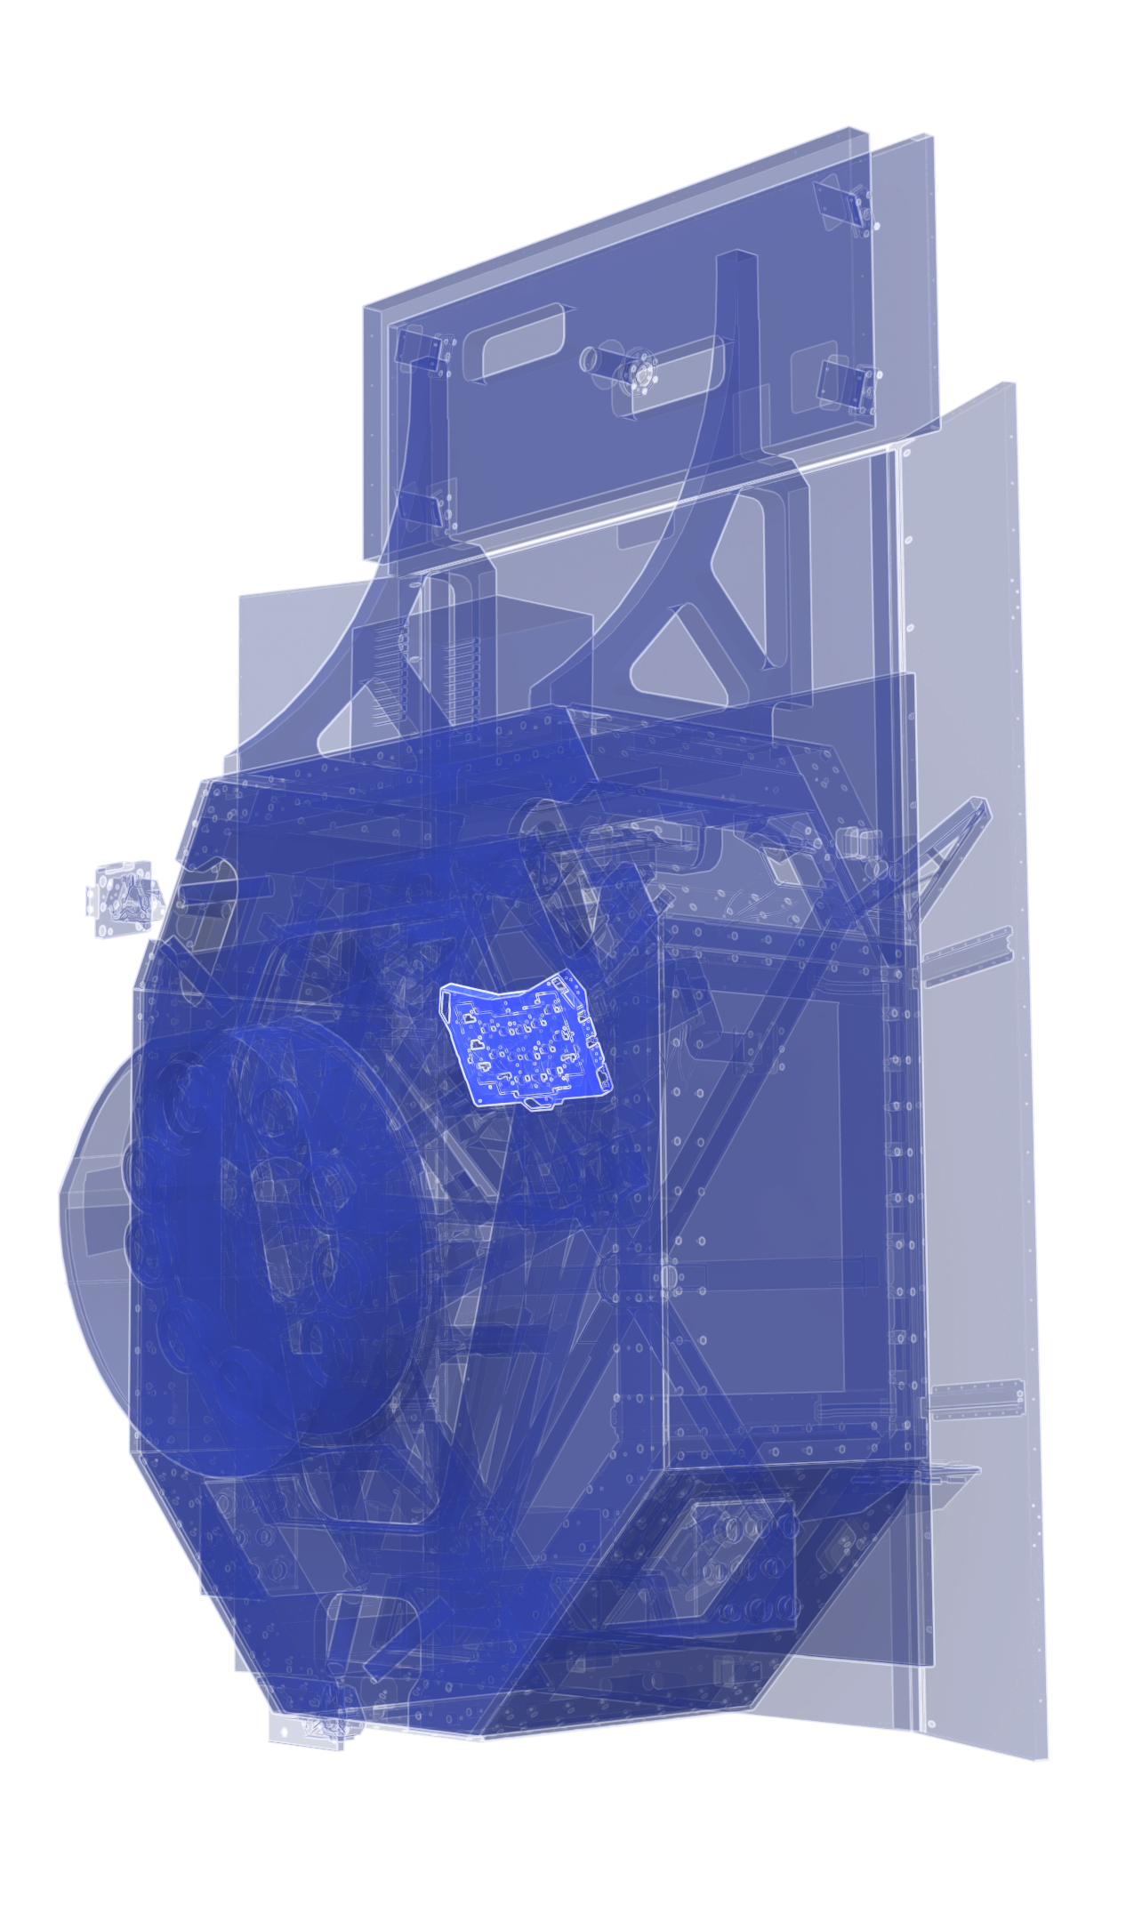
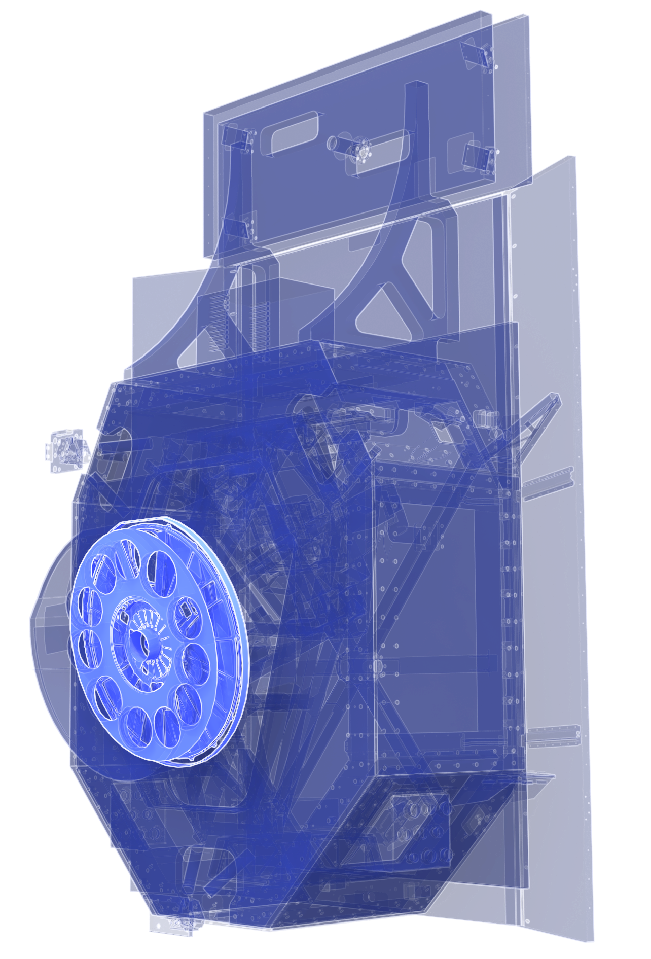
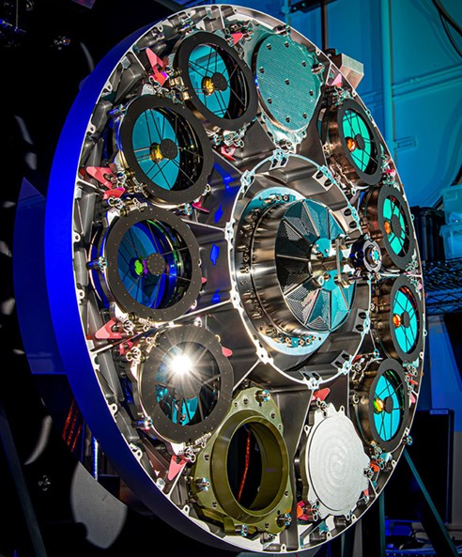
Wide Field Instrument (WFI)
Focal plane array of 18 Teledyne 4k × 4k detectors
Element wheel enables imaging and slitless spectroscopy (grism and prism disperse light by wavelength) spanning 0.48 to 2.3 μm
Ground tests have demonstrated we have an incredibly high performing science instrument
Notes:
https://svs.gsfc.nasa.gov/14181

Slide 15
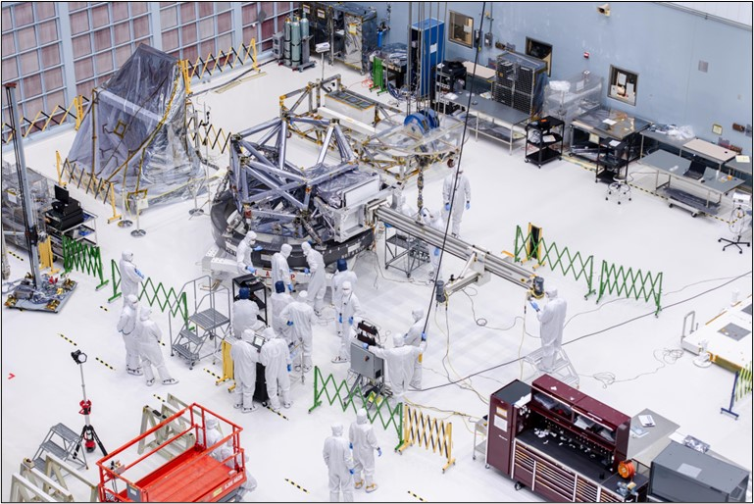
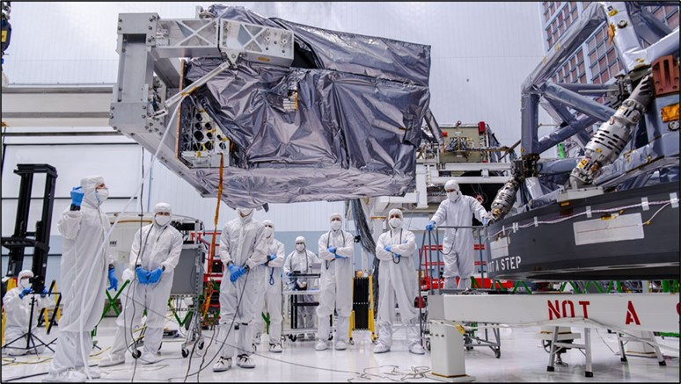
Roman Coronagraph
Date: Late October 2024
Notes:
Sources: cleared photos directory

Slide 16
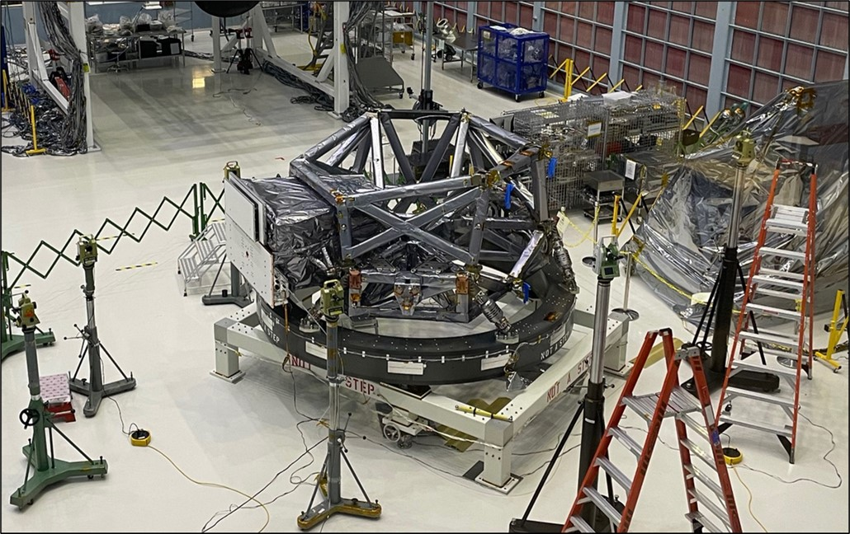
Roman Coronagraph Integration
Date: Late October 2024
Notes:
Sources: cleared photos directory

Slide 17
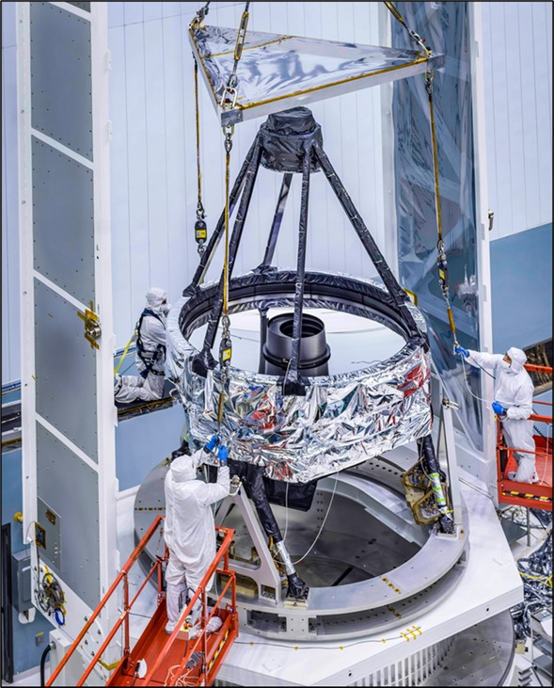
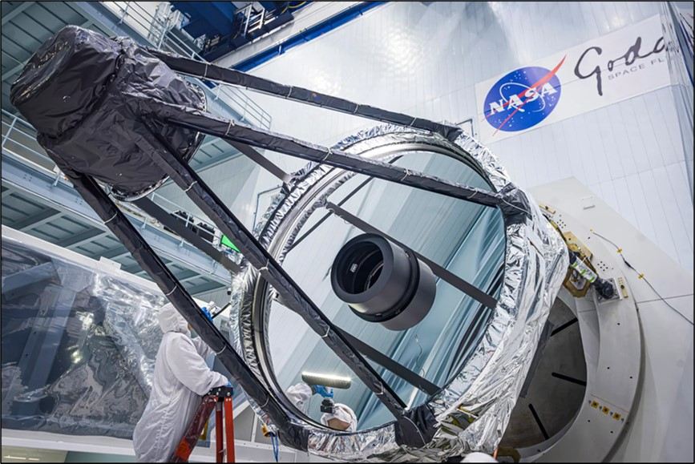
Optical Telescope Assembly
Date: Late November 2024
Notes:
Sources: cleared photos directory

Slide 18
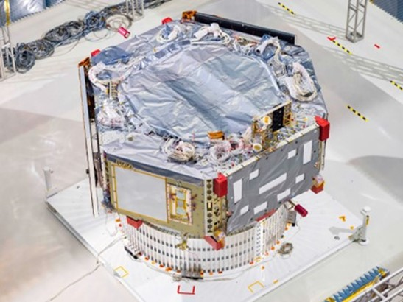
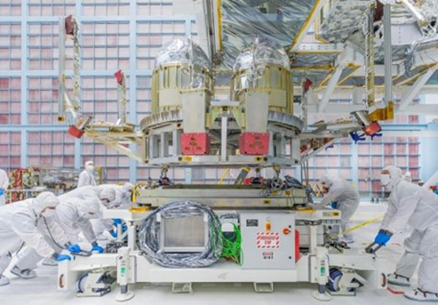
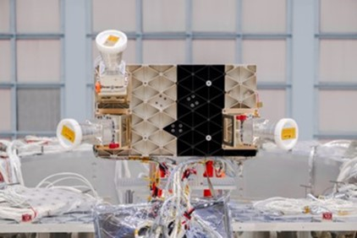
Roman Spacecraft
ST/IRU Bench
Spacecraft Bus
Propulsion Module

Slide 19
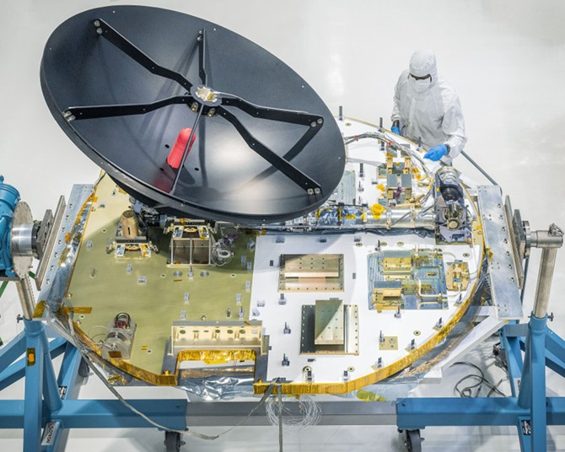
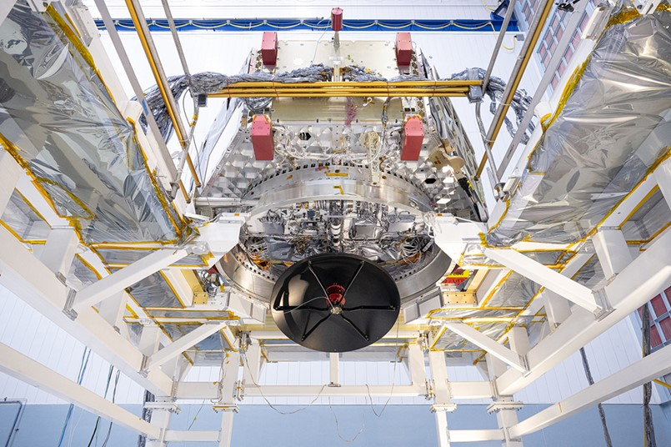
Roman Spacecraft
Communications Module
Notes:
On the bottom of the Spacecraft bus is the Communications Module, which contains the deployable, 1.7m dual-band (S- and Ka-) gimbaled high gain antenna, the dual-axis (Azimuth/Elevation) antenna pointing system, and the Radio Frequency (RF) communications hardware. During the nominal mission, S-band communications is used for command uplink and housekeeping telemetry downlink and Ka-band communications is used for high-speed science data downlink. The RF subsystem also includes two omni S-Band antennas for initial post-launch communications (until the High Gain Antenna is deployed) and for contingency communications during the operational mission.

Slide 20
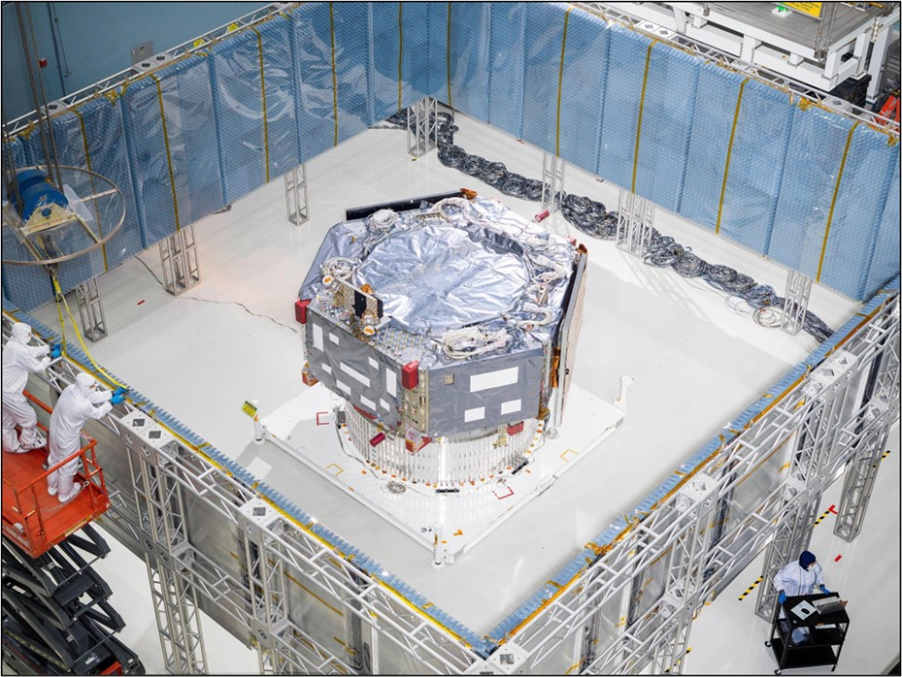
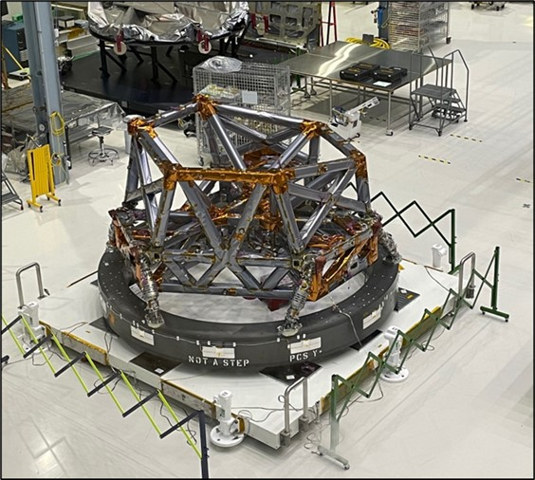
Spacecraft Bus and Instrument Carrier
Date: Late September 2024
Notes:
Sources: cleared photos directory

Slide 21
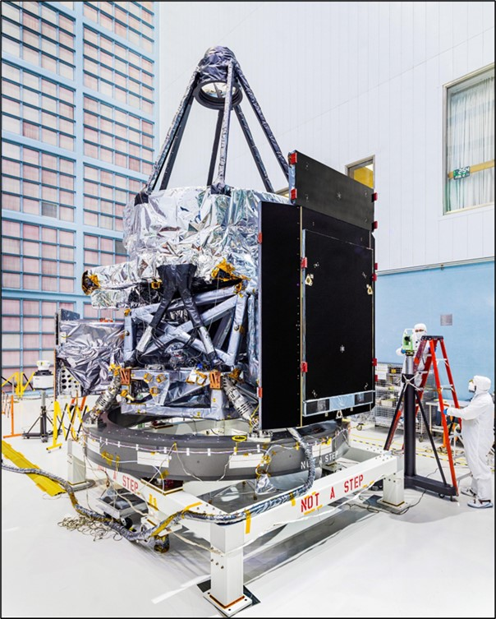
Integrated Payload Assembly
Date: Dec 10, 2024
Notes:
Sources: cleared photos directory

Slide 22
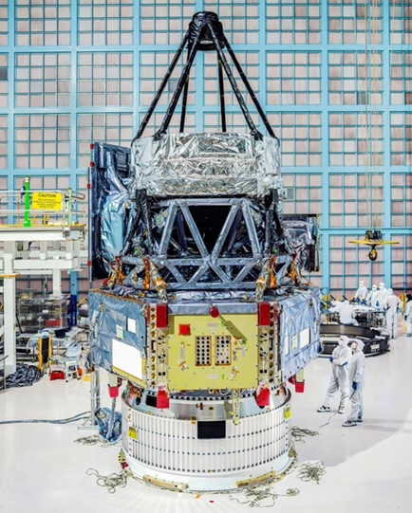
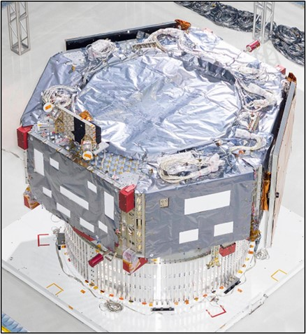
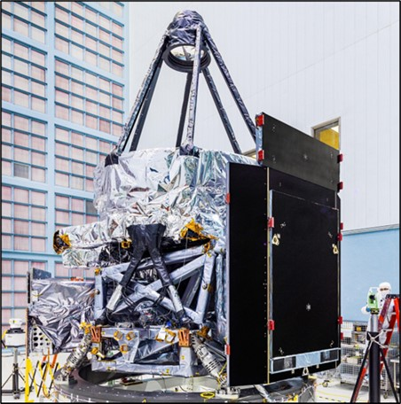
Integration of SCIPA
Spacecraft and Integrated Payload Assembly (SCIPA)
Integrated Payload
Assembly (IPA)
Spacecraft Bus (SC)
+
=
Date: Week before Christmas
Notes:
Sources: cleared photos directory

Slide 23
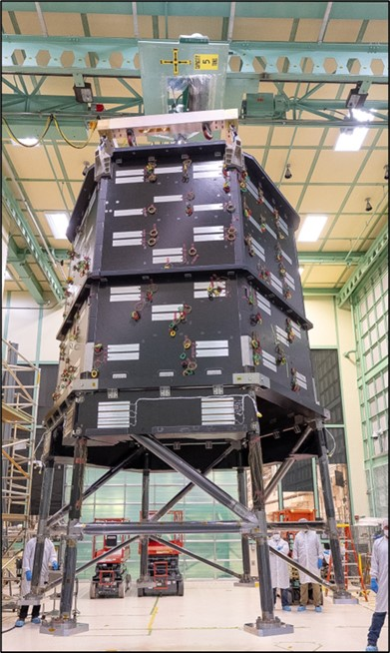
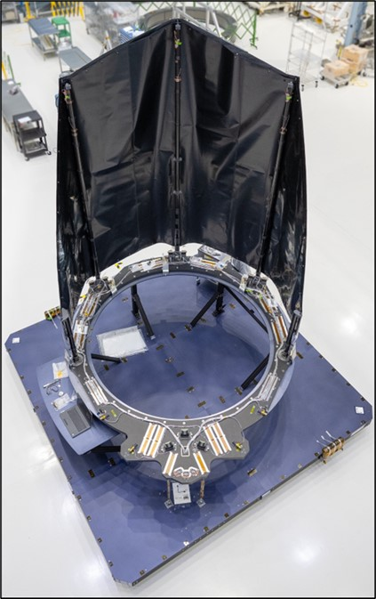
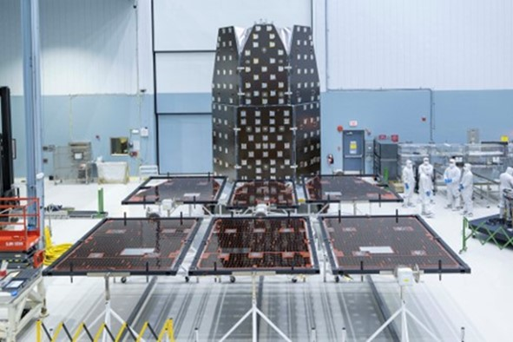
OBA/SASS/DAC
Outer Barrel
Assembly (OBA)
Deployable Aperture Cover (DAC)
Solar Array Sun Shield (SASS)
Notes:
Sources: cleared photos directory

Slide 24
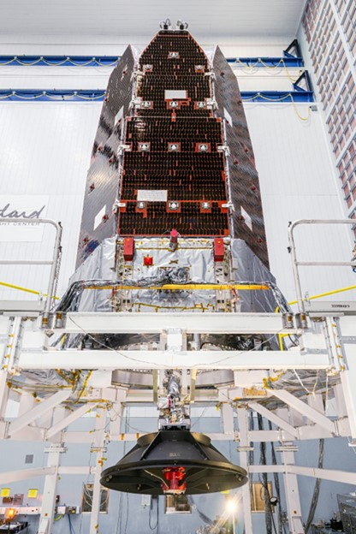
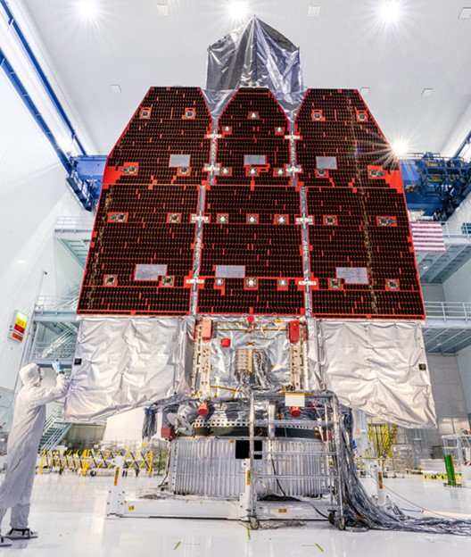
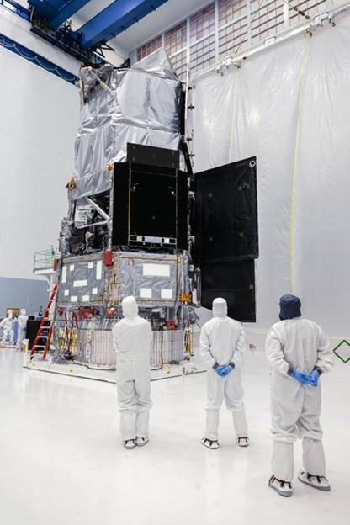
Roman Observatory Complete!

Slide 25
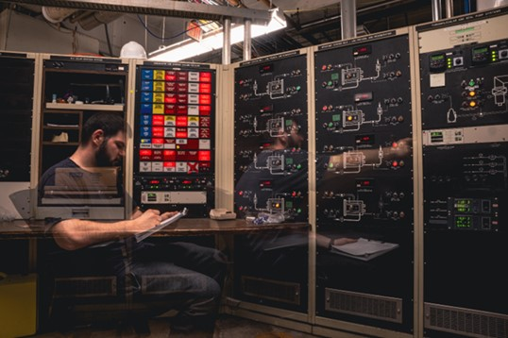
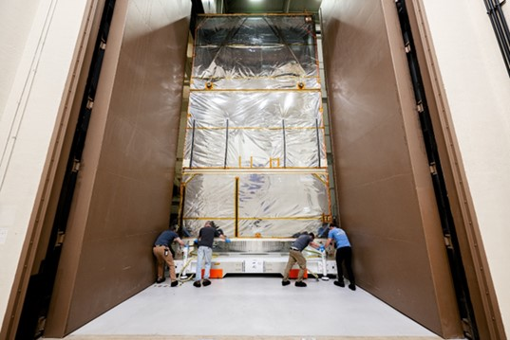





Observatory Testing

Slide 26


Ready to Ship!

Slide 27
Mission Operations

Slide 28

Pre-Launch and Launch
Launch Services Program (LSP) selected SpaceX Falcon Heavy for Roman
  Single-mission launch; no secondary payloads or rideshares
  Enables a +/- 15 sec launch window (was instantaneous) for collision avoidance purposes
Roman processing is in the Payload Hazardous Servicing Facility (PHSF) at Kennedy Space Center
Two first flight items for Roman/LSP
  3100 separation system: LSP engineering reviewed test data from HALO+PPE and Roman from Beyond Gravity
  Strut Payload Attach Fitting (PAF): SpaceX previously flew on Bluebird 1, a commercial mission (September 2024)
Launch Readiness Date: 8/30/2026
Pre-Launch Blog: https://science.nasa.gov/blogs/roman/

Slide 29

Commissioning and Baseline Science Mission
Observing Programs & Characteristics | Observing Programs & Activity Characteristics
HLWAS | Survey Area: 1700 sq-deg using 10.5 sq-deg sectors WFI Imaging: 2 passes using 4 NIR filters / Spectroscopy: 4 passes using grism Deep-Field Observations: 10% of representative time allocation
HLTDS | (146) 30-hour passes over a 2-year period Multi-Tier WFI Imaging: 5.3 & 16.0 sq-deg sectors using 6 NIR filters Multi-Tier WFI Spectroscopy: 1.1 & 3.4 sq-deg sectors using grism element
GBTDS | (6) 62-day seasons over the mission 2 sq-deg region repeated every 15 minutes WFI Imaging: Wide filter used primarily; other filters used less frequently
GAS | Full sky availability throughout the mission for WFI imaging & spectroscopy
ECP | Multiple CGI observing campaigns over the initial 18-months of the mission Imaging-Narrow FOV, Imaging-Wide FOV, Spectroscopy, Calibration
 | WFI Calibration Activities (Detector, Imaging, Spectroscopy)
HLWAS – High Latitude Wide Area Survey; HLTDS – High Latitude Time Domain Survey; GBTDS – Galactic Bulge Time Domain Survey; GAS – General Astrophysics Surveys; ECP – Exoplanet Coronagraphy Program; WFI – Wide Field Instrument; CGI – Coronagraph Instrument; NIR – Near Infrared; FOV – Field Of View; DITL – Day In The Life; WITL – Week In The Life; ETE – End To End
Mission Operations Activity Characteristics | Mission Operations Activity Characteristics
Libration Orbit Insertion | 24 hours, post-commissioning
Momentum Unloading | 60 min (WFI: every 4 days, CGI: every 6-22 hrs during slews)
Orbit Maintenance (Station-Keeping) | 60 min (every 28 days)
Payload Focus/Alignment Maintenance | 20 activities over 5-year mission
Engineering Activities (e.g. FSW loads, Cmd Auth key management) | 24-hour allocation per year
Anomalies/Safemodes | 96-hour allocation per year

Slide 30
backup

Slide 31

(All Roman data will be publicly available)
Notes:
Eclipse hubble archive in just over 2 weeks

Slide 32


