Slide 1
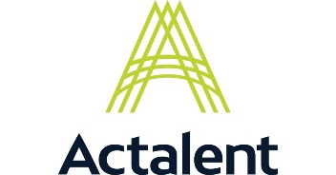
Actalent
March 12th, 2025
Size Standard | Large Business, 26k+ employees, 150 offices across the United States. Est. 1983.
Corporate Description |  | Consulting and Engineering Services
Organizations we support at Goddard |  | Support multiple organizations and projects across GSFC. Setup as a strategic subcontract partner.
Goddard Contracts |  |  |  | Capabilities
MIST II |  |  |  | Mechanical engineering design, integration, test. Materials engineering support.
FDSS III |  |  |  | Flight dynamics and orbital analysis support. Systems engineering.
GSMO III |  |  |  | Mission operations support to multiple active programs and pre-launch ground systems integration.
Other NASA Centers Supported |  |  |  | Capabilities
Johnson Space Center |  |  |  | Engineering development for human spaceflight missions & technology.
Kennedy Space Center |  |  |  | Range support engineering, facilities and software engineering.
Marshall Space Flight Center |  |  |  | Design and development for propulsion systems/ SLS.
Capabilities in Other Markets that could benefit Goddard’s Mission |  |  | Offsite engineering design centers in MI, TX, IL, KY, NC, OH, AZ, AL, OK and VA. Proprietary database of over 41 million resumes of consultants from current, former and future roles.

