Slide 1
Overview of the GSFC Integrated Design Center (IDC)
Yesterday’s dream, today’s concept, tomorrow’s reality.
Jennifer Medlin Bracken
IDC Manager
301-286-5127
Jennifer.M.Bracken@nasa.gov
NASA Goddard Space Flight Center

Slide 2
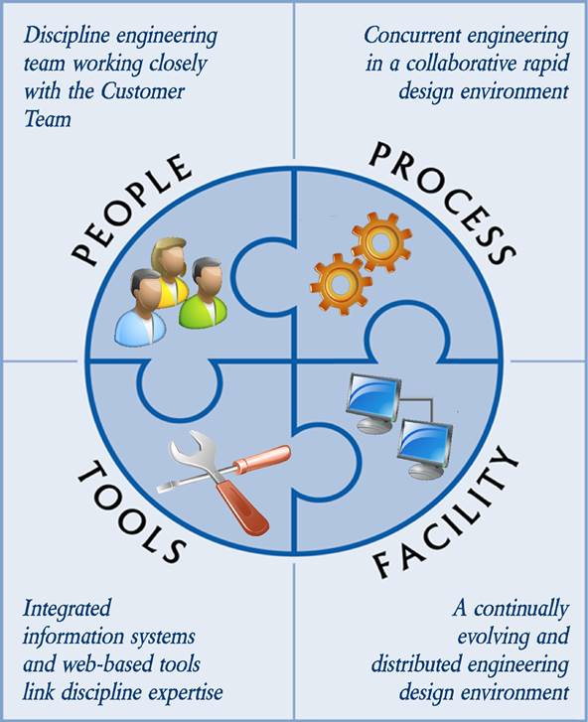
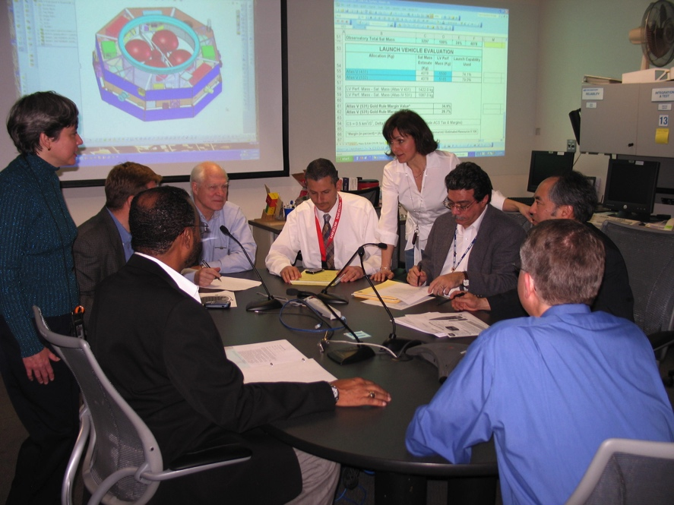
Integrated Design Center (IDC)
An environment that facilitates multi-disciplinary, concurrent, collaborative, space system engineering design and analysis activities,
to enable rapid development of science instrumentation, mission, and mission architecture concepts.

Slide 3
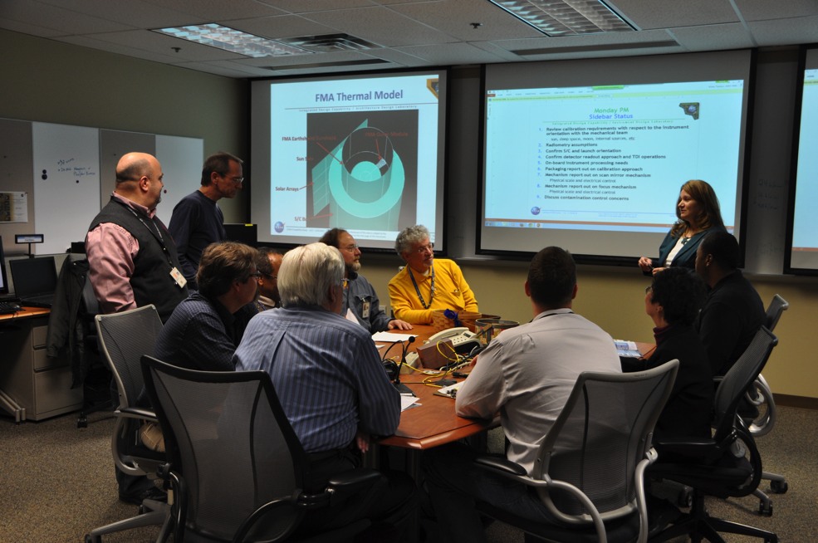
IDL – Services and Capabilities
Services:
End-to-end instrument concept development
Existing instrument/concept architecture evaluations
Trade studies and engineering evaluations
Technology, risk, and independent assessments
Requirement refinement and science traceability
Mass, power, data resource allocation
Vendor RFQ evaluation
Cost estimation
Capabilities:
Conceptualize instruments that make measurements at wavelengths across the entire electromagnetic spectrum, including x-ray, gamma ray, ultra-violet, visible, infrared, and microwave instruments
Address instrument families ranging from telescopes, cameras, lidars, spectrometers, polarimeters, coronographs, radiometers, mass spectrometers, etc.
Model various flight environments, including LEO, GEO, libration, retrograde, away, lunar, deep space, and planetary orbiters, landers, and probes
Realize instruments for different flight platforms, including space station, balloon, sounding rockets, and UAV instrument design environments
Consider non-distributed and/or distributed instrument systems as well as robotic servicing, planetary rovers, and sample return

Slide 4
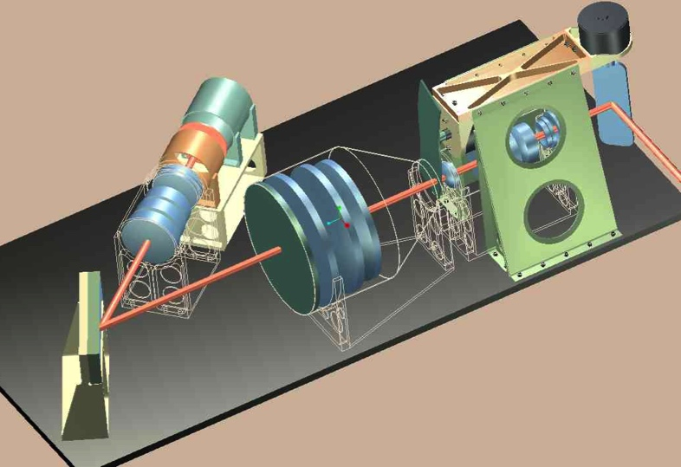
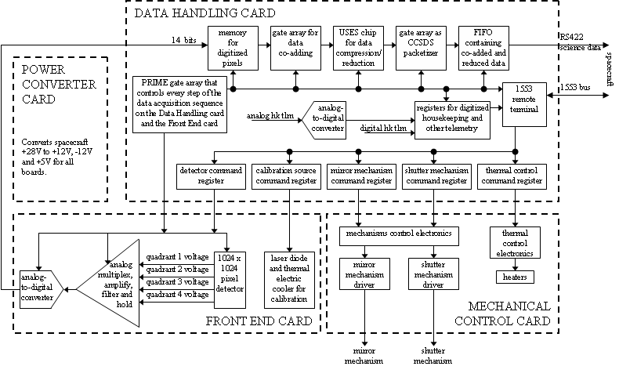
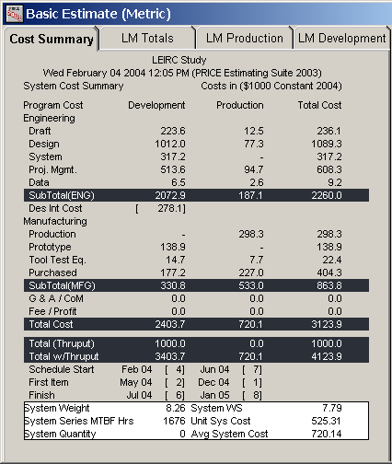
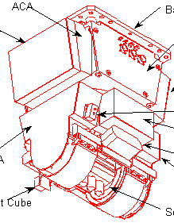
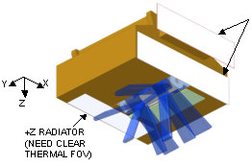
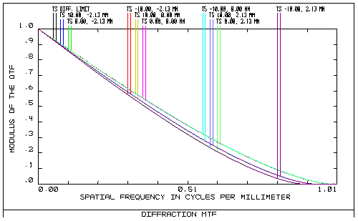
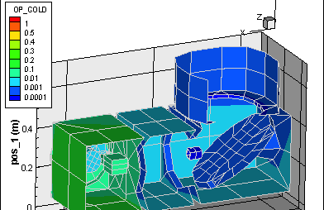
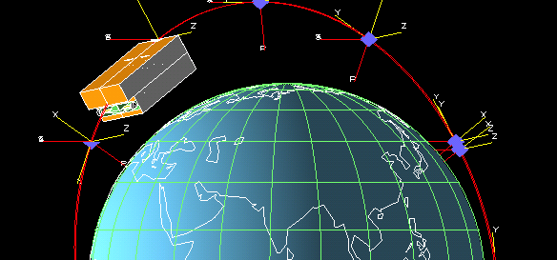
IDL Product Examples
Electrical Subsystem Architecture
Cost Modeling
Mechanical Packaging
Mechanism
Design
Radiator
Placement
Optical Performance Assessment
Thermal Modeling
4
Contamination Assessment

Slide 5
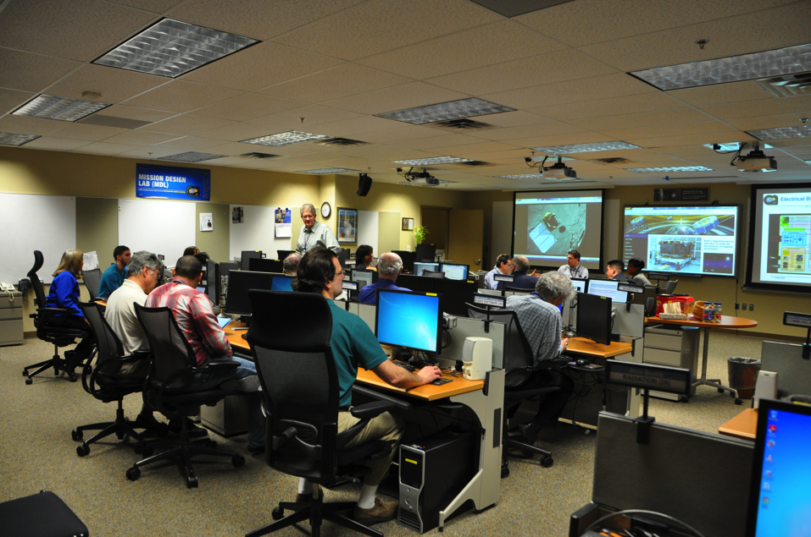
MDL – Services and Capabilities
Services:
End-to-end mission concept development
Engineering evaluations
Trade studies
Technology, risk, and independent assessments
Requirement refinement and science traceability
Mass, power, data resource allocation
Master Equipment Lists for cost modeling
Full Range of Capabilities:
Standard and low thrust trajectory design to LEO, GEO, libration, lunar, and deep space locations
Observatory design of single spacecraft, constellations, formation flying, and distributed systems
Ground system concept development, including services and products
Launch vehicle accommodations
End-of-Mission considerations including controlled and uncontrolled de-orbit, reconnaissance and landing, sample return, etc.

Slide 6
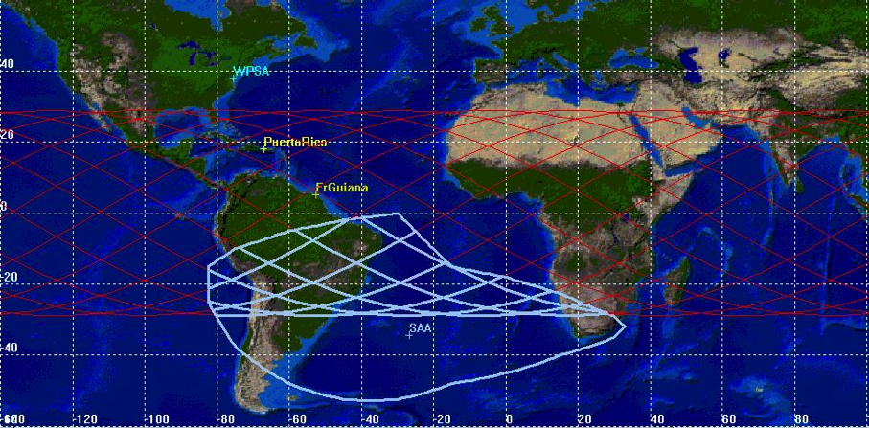
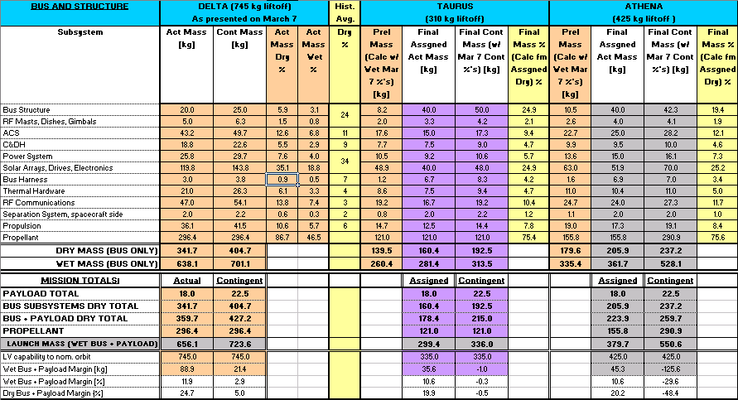
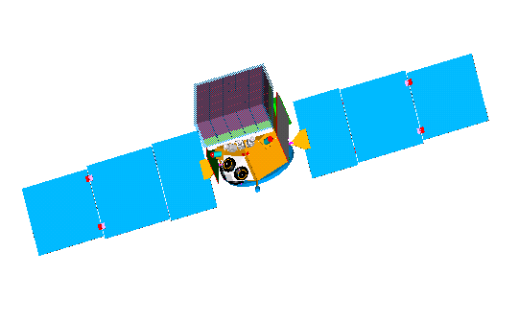
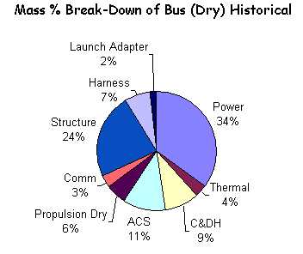
MDL Product Examples
Systems Engineering, I&T, Operations,
Risk Assessment, Mission Costing
Spacecraft Systems Block Diagrams
and Performance Analyses
Launch Systems Accommodations
and Performance Analysis
Orbit, Communications, Ground Systems,
Environmental Analyses
Parametric Assessment
Mechanical Configurations
and Thermal Analyses

Slide 7
People
Mission Design Lab (MDL/ADLm)
Instrument Design Lab (IDL/ADLi)
Lab Lead
MDL Systems Engineers
Lab Leads
IDL Systems Engineers
Mission Cost
Instrument Cost
158
Mission Operations
158
Detectors
Reliability
581
Reliability
553
371
Flight Software
371
Electro-optics/Lasers
Structural
582
Experienced,
knowledgeable
engineers
available
for
all
required
disciplines.
Materials
554
542
Ground Systems
541
Microwave Systems
Mechanical Systems
583
Structural
555/567
543
Attitude Control
542
Radiation Environment
Thermal
591
Mechanical Systems
561
545
Orbital Debris
543
Instrument Electronics
Contamination
592
Electro-mechanical
564
546
Planetary Protection
544
Integration and Test
Mechanical Designer
592
Thermal
568
547
Flight Dynamics
545
Flight Software
Radiation Environment
595
Contamination
582
561
Team Lead
546
Fine Guidance
Power Systems
599
Mechanical Designer
591/595
563
Mission Systems Engineer
547
Instrument Systems Engineer
Avionics
599
Team Lead/
Deputy Team Lead
592
565
Launch Vehicle
550
Planetary Protection
Communications
599
Optics
592
566/567
Propulsion
551
Orbital Debris
Integration and Test
597
Cryogenics
592
568
552

Slide 8
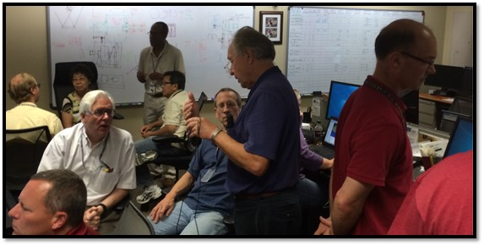
Process
Concurrent, collaborative, systems engineering:
All required engineering disciplines work simultaneously for study duration
Customer team integrated into design process
Systems Engineers infuse end-to-end system and mission life-cycle perspectives
Lab Lead manages customer needs, schedule, product consistency and quality
Rapid, responsive, evolving concept design development:
Evaluate and iterate concept design in real-time
Discipline engineers use consistent conventions to represent the design
Systems engineers use collaborative tools to rack up engineering resources
Routine study milestones are used to evaluate progress and make key decisions
Proven approach:
Within a reasonable scope of work,
the outcome of the study is credible
and costable

Slide 9
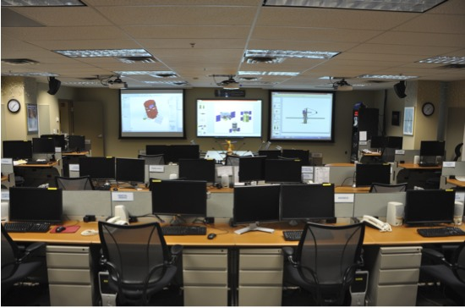
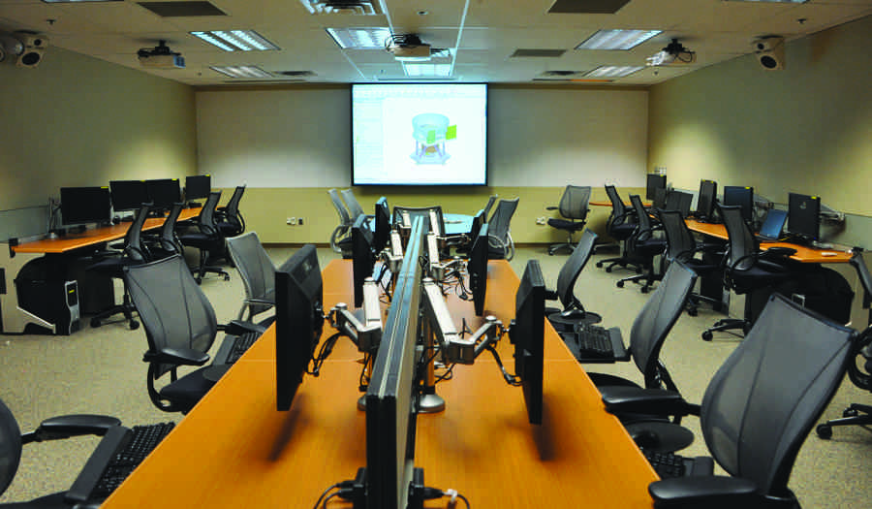
Facilities
State-of-the-art engineering workstations, software and information technology to ensure engineering excellence.
Mission Design Lab (MDL)
Comfortable, well-equipped workspaces to facilitate dynamic interaction within team
Instrument Design Lab (IDL)

Slide 10
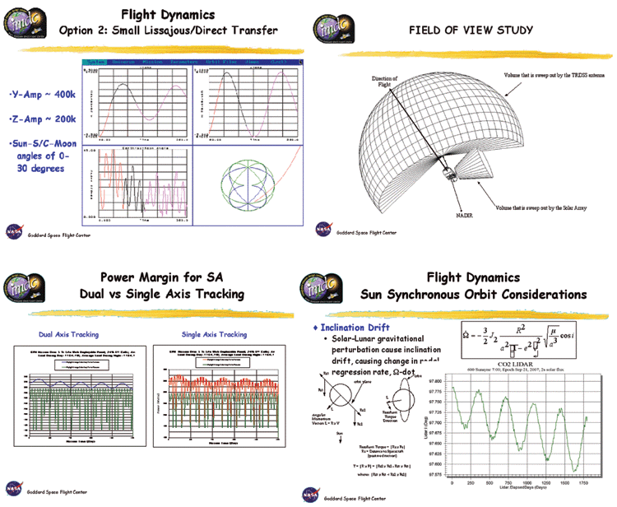
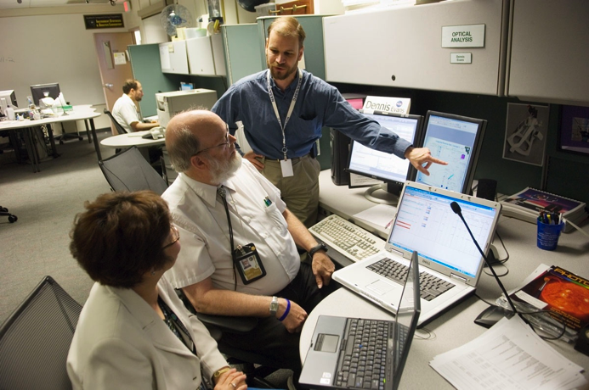
Tools
Software
Mix of Commercial-Off-The-Shelf (COTS) and homegrown engineering software such as:
STK/Free Flyer, 42 - Working Model 2D
NX, CREO - ZK Spreadsheets
FEMAP - SolidWorks
MathCAD - SINDA
Mathematica - CATTENS
PATRAN/NASTRAN - ZEMAX, Code V
MATLAB/Simulink - TSS/Thermal Desktop
Systems engineering integration software
Automatic gathering, integration and display of engineering parameters
Hardware
State-of-the-art computing platforms
Independent, integrated IT solutions
Servers, networks, web-drives
Communication and audio-visual
WebEx, station telecom, projection, product preparation

Slide 11
IDC Value
Partners:
All NASA centers and all NASA enterprises
Other Government Agencies
Academia and research institutions, national and international
Industry, national and international
Services:
Customized end-to-end concept studies
Focused studies
Early concept consultations
Independent evaluations
Technology, risk, and cost assessments
Capable of supporting local and geographically distributed teams
Stakeholders:
Science and Human Exploration LOBs
New Opportunities Office
Technologists
NASA Headquarters (strategic planning)
Decadal Surveys
AO Formulation
Studies:
Instrument/Mission/Enterprise architecture
Mission/Instrument pre-formulation
AO proposals
Mission/Instrument formulation
Technical evaluations
Engineering validation

Slide 12
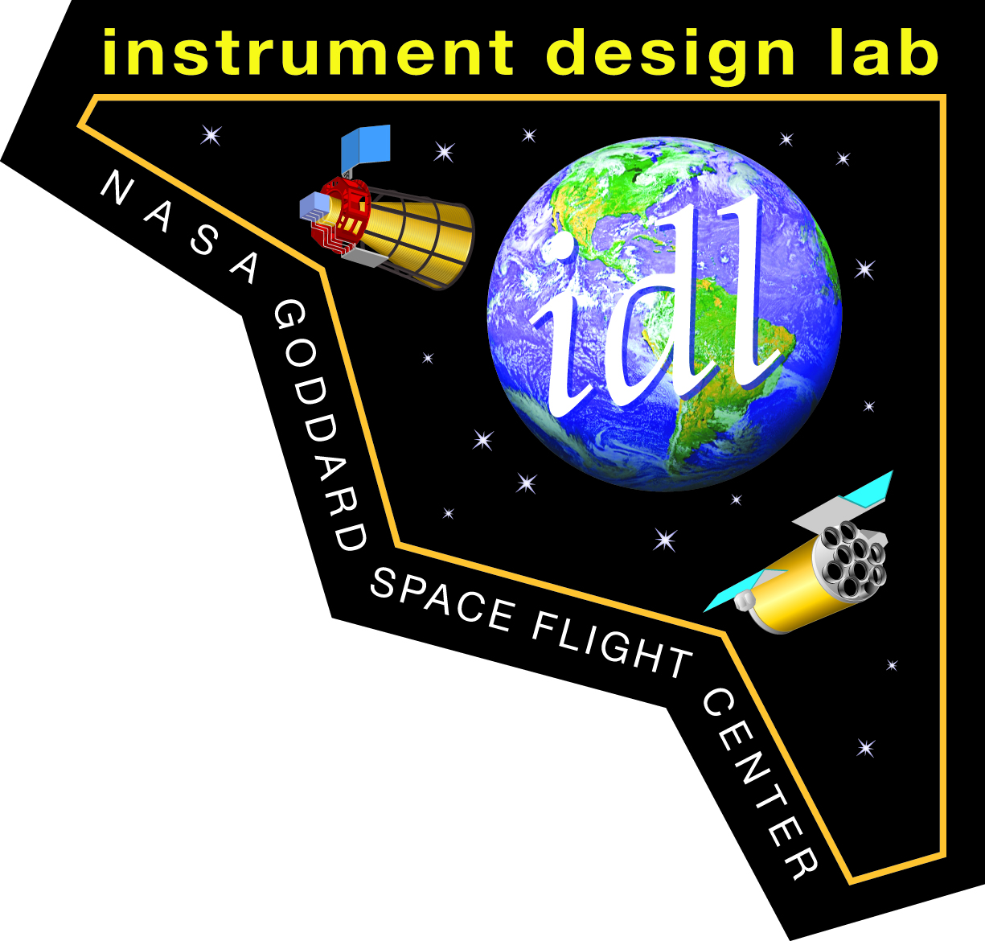
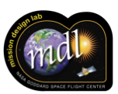
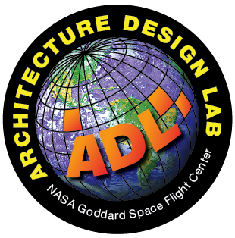
Instrument Design Lab (IDL) - offering conceptual design and analysis of instrument systems (building 23, room C340)
Mission Design Lab (MDL) - offering conceptual end-to-end mission design and analysis (building 23, room C318)

Slide 13
IDC Inception and Evolution
Mission Design Lab (MDL)
Created in 1997
Initially known as the Integrated Mission Design Center (IMDC)
394 completed studies
Instrument Design Lab (IDL)
Created in 1999
Initially known as the Instrument Synthesis & Analysis Laboratory (ISAL)
271 completed studies
Integrated Design Center (IDC)
Created in 2001
Initially known as the Integrated Design Capability (IDC)
Grand total: 699 completed studies
Architecture Design Lab (ADL)
Created in 2012
Filled need for additional flexibility with broad types of architecture studies
34 completed studies
NASA Goddard Space Flight Center — Integrated Design Center
13

